Slide 1
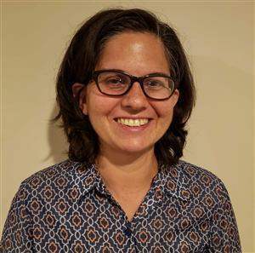
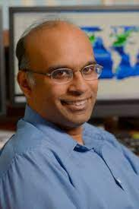
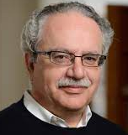
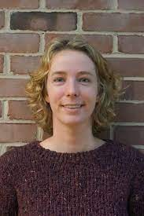
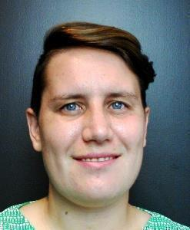
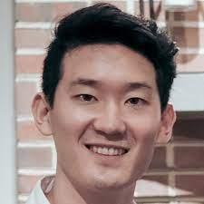
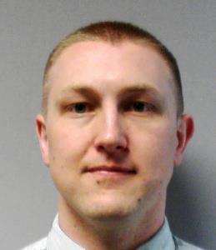
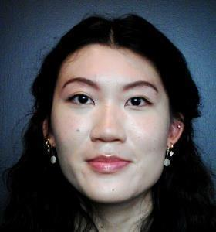

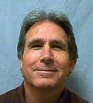
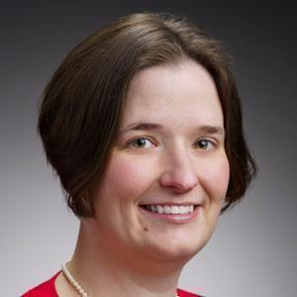
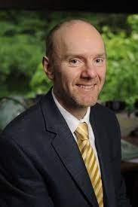
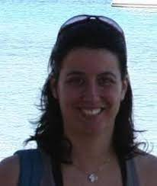
Neuro-Symbolic Learning and Large Language Models: Paving the Way for Automatic Scientific Discovery
Jennifer Sleeman, Ph.D.
Senior AI Researcher
Johns Hopkins University Applied Physics Laboratory
Research Assistant Professor
University of Maryland, Baltimore County
My awesome collaborators:
Anand Gnanadesikan (JHU)
Yannis Kevrekidis (JHU)
Thomas Haine (JHU) Marie-Aude Pradal (JHU). Renske Gelderloos (JHU)
Jay Brett (APL) David Chung (APL) Chace Ashcraft (APL) Caroline Tang (APL) Anshu Saksena (APL) Larry White (APL) Marisa Hughes (APL)
Approved for public release; distribution is unlimited. This material is based upon work supported by the Defense Advanced Research Projects Agency (DARPA) under Agreement No. HR00112290032.

Slide 2
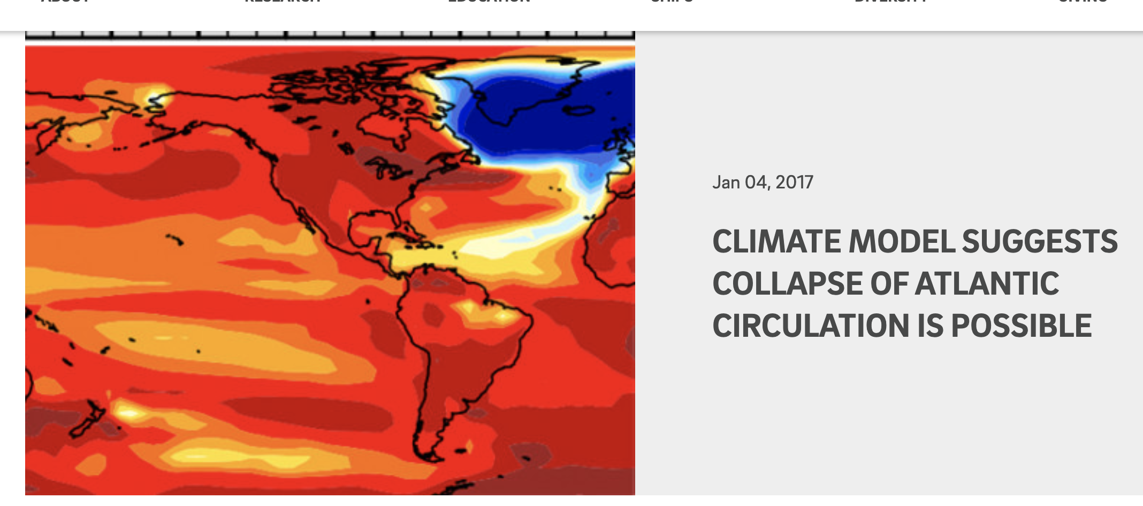
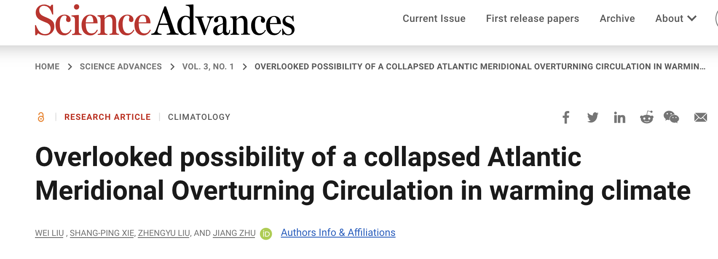
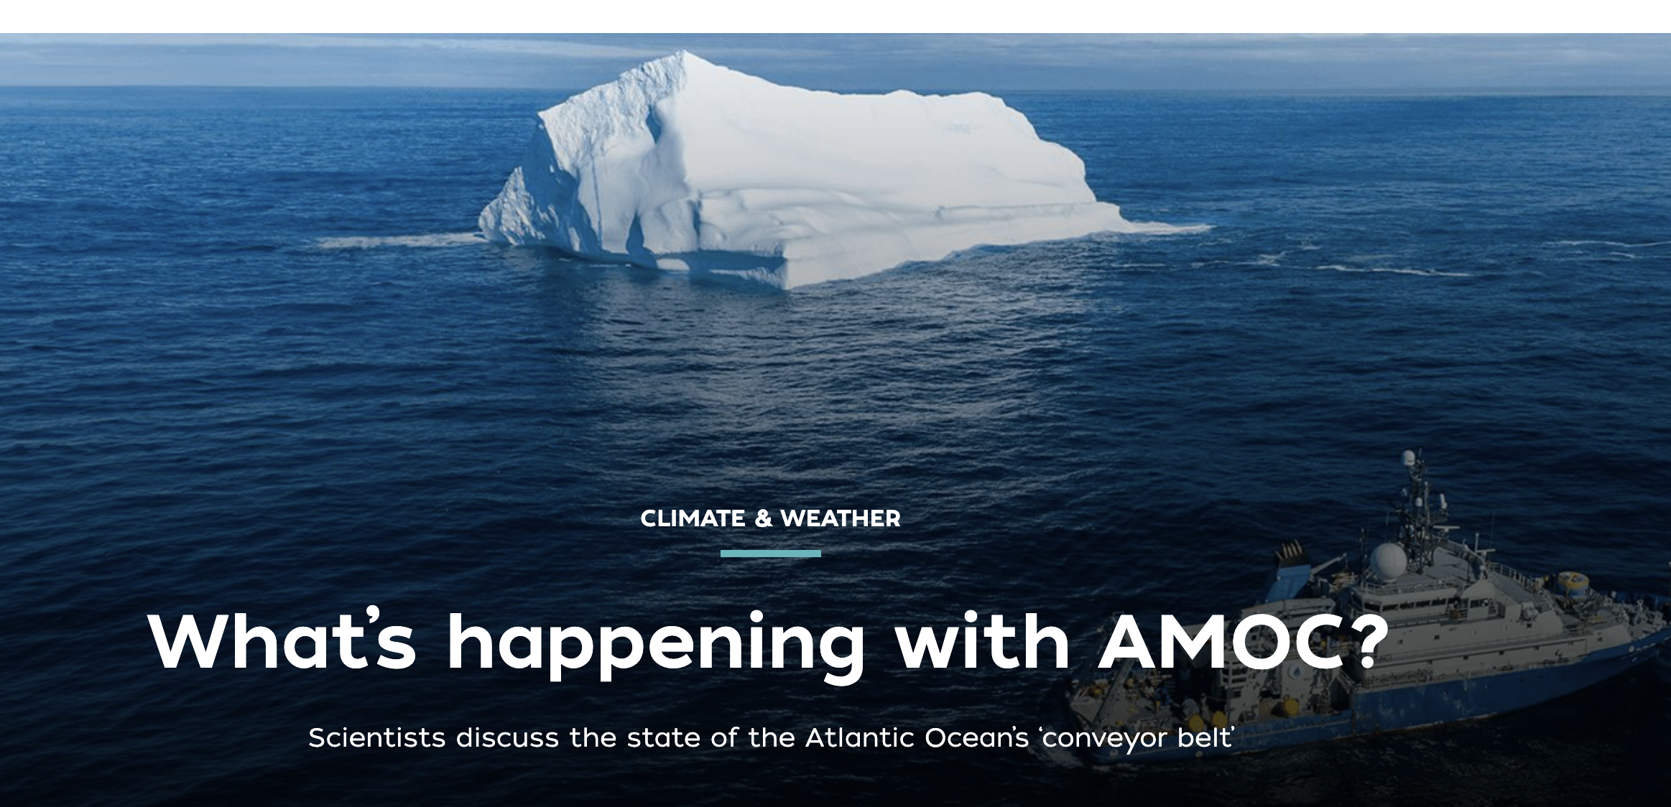
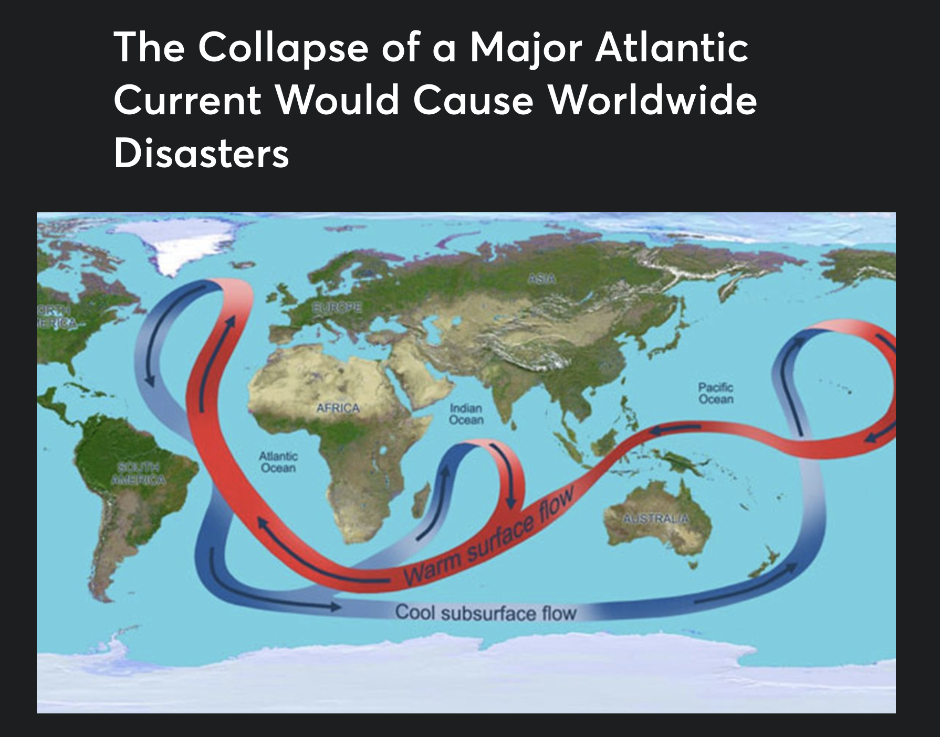
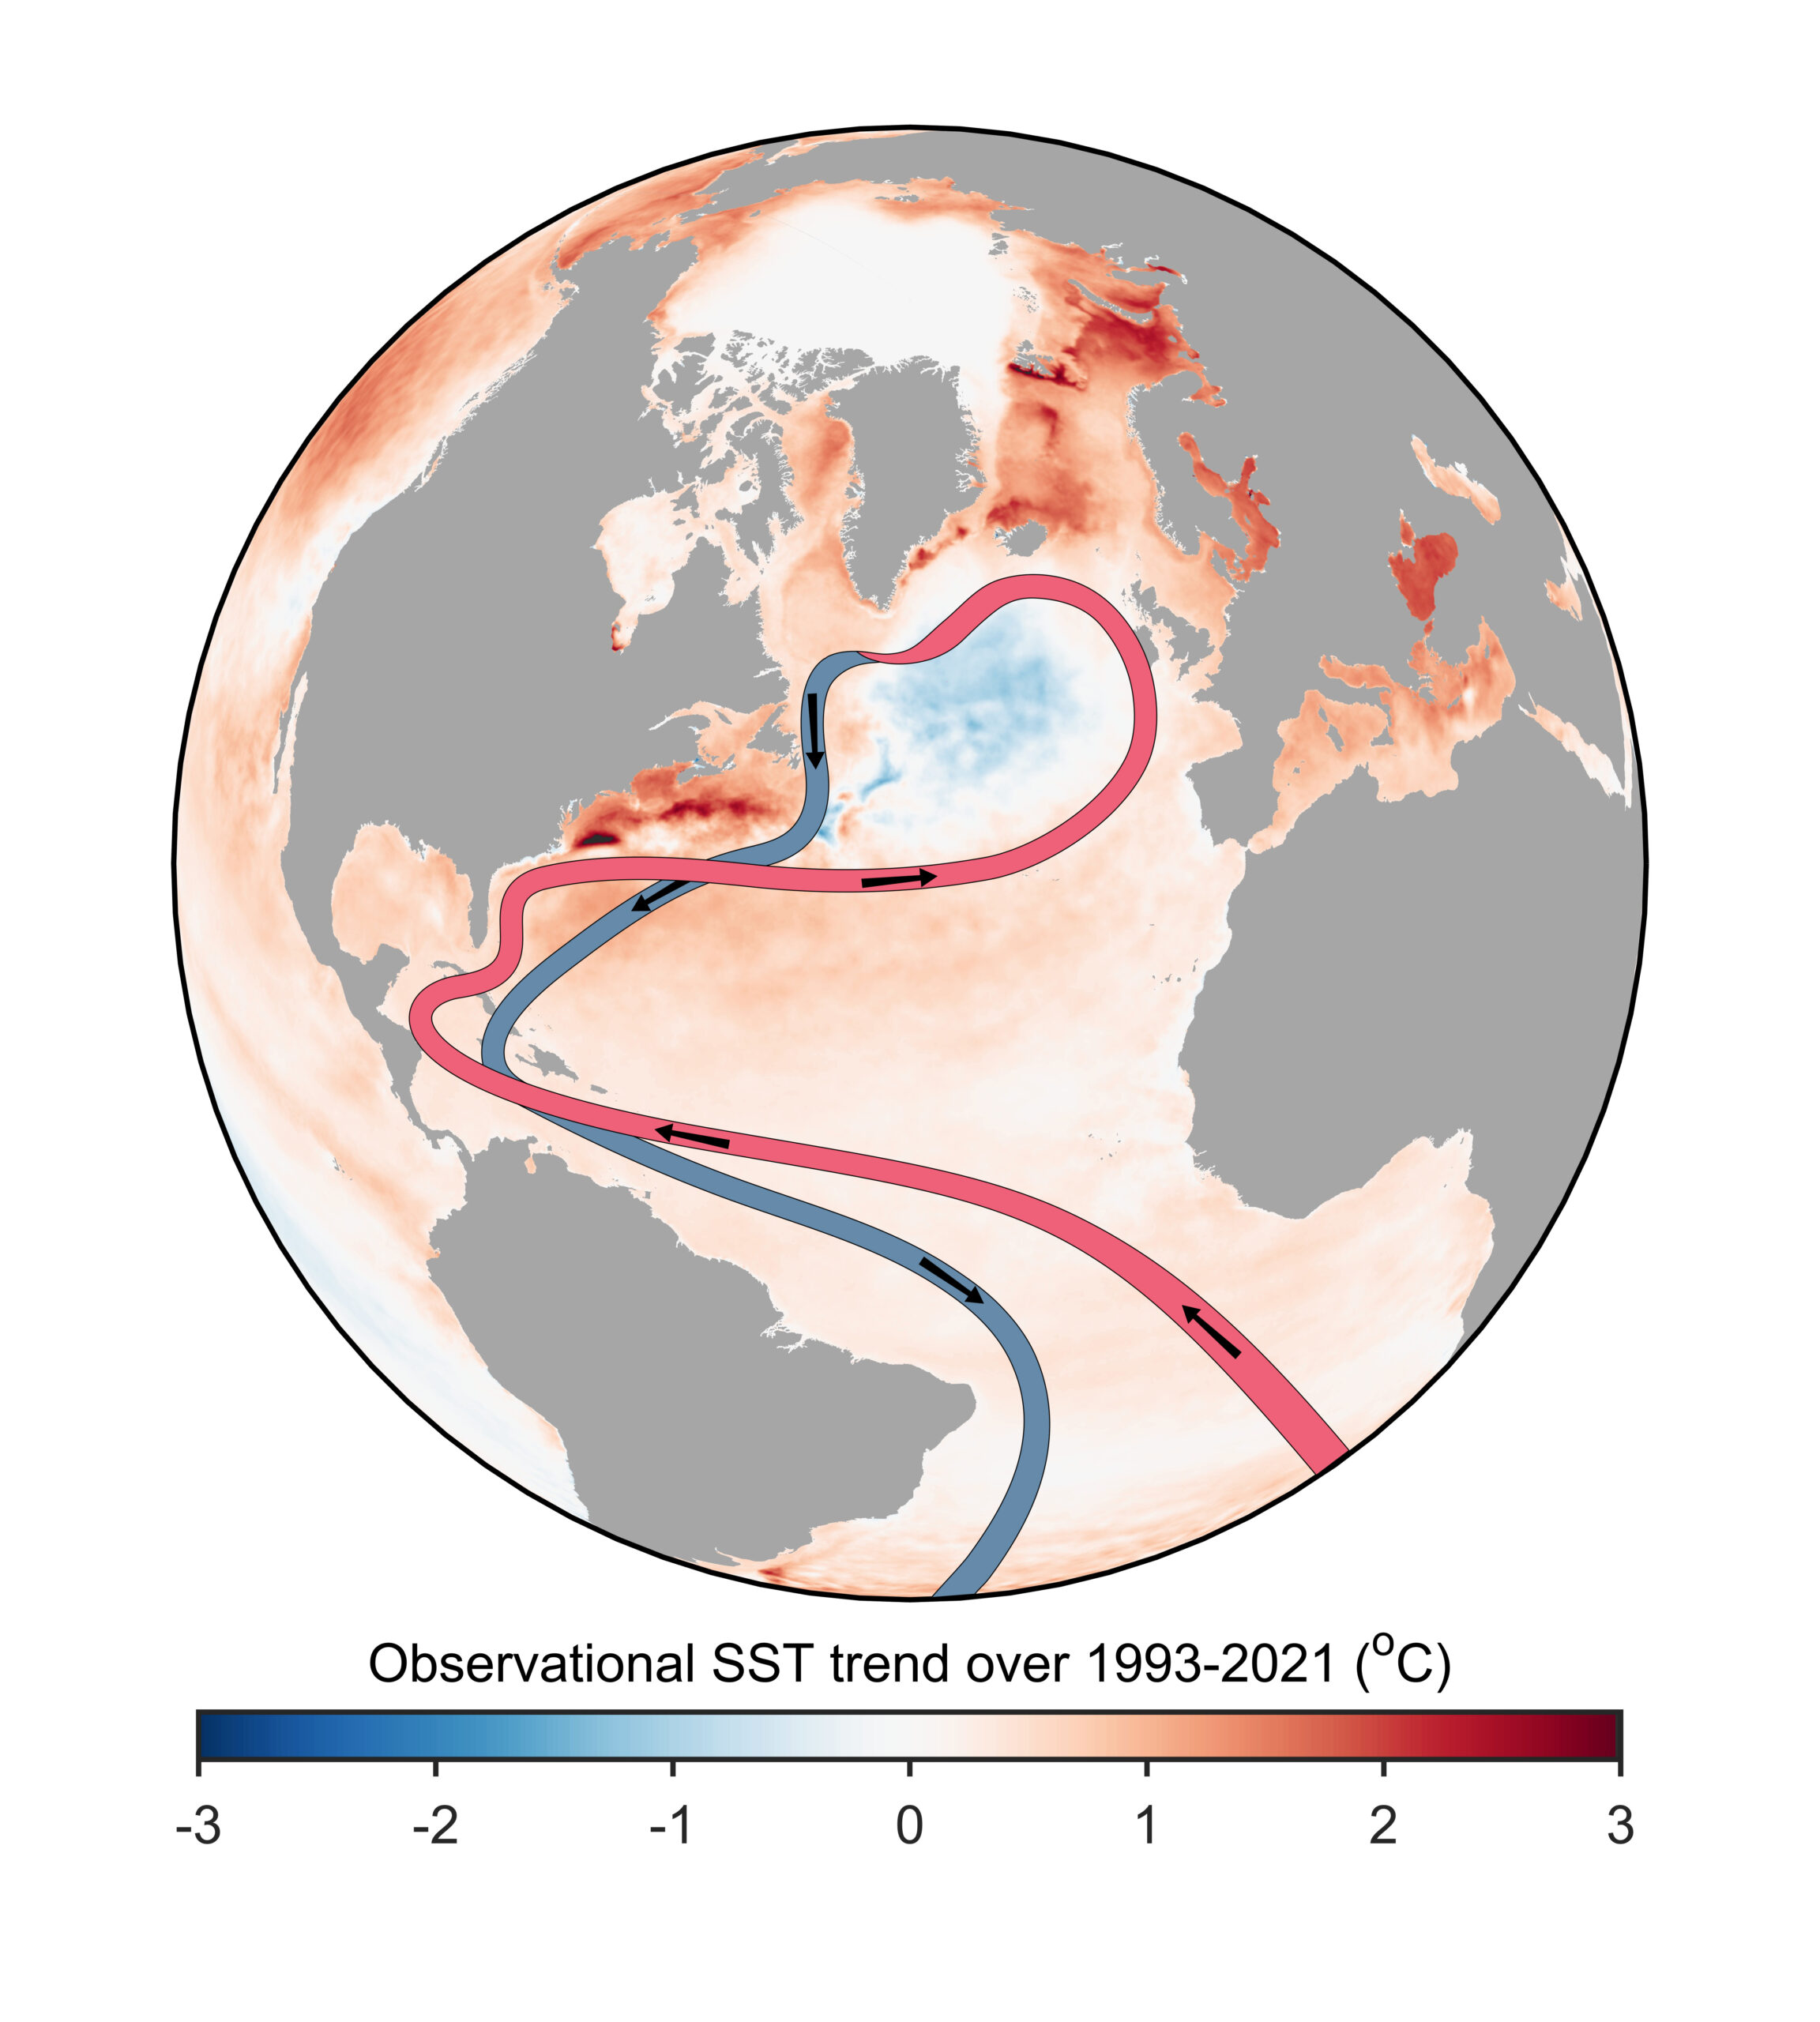
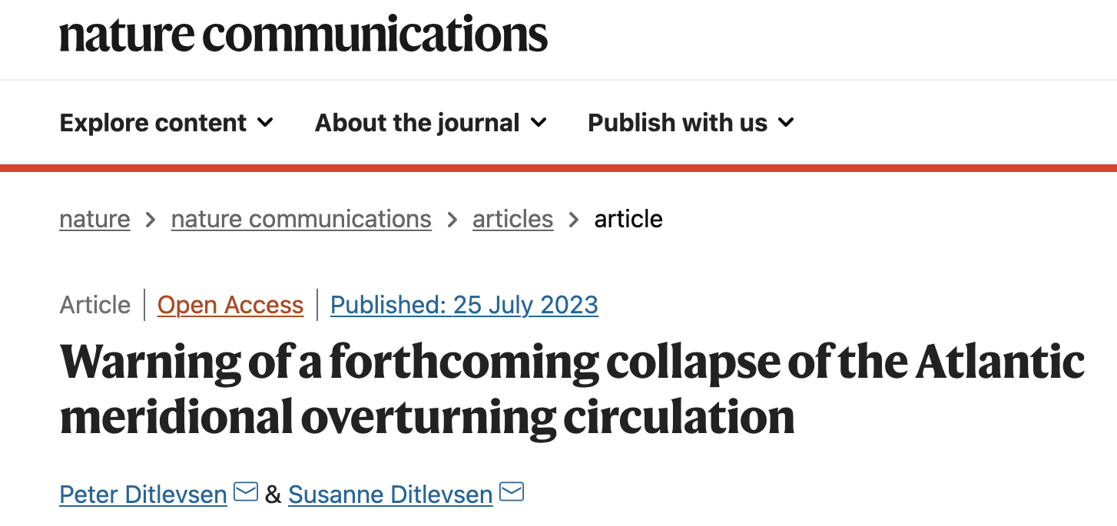

If scientists are going to use Artificial Intelligence as a scientific discovery tool…
AMOC – “The conveyer belt of the oceans”
…They need to be able to ask scientific questions that can be parsed, interpreted, and answered by AI.
Does the stability of the overturning depend on the pathways and sensitivities of water mass transformation in the Southern Ocean?

Slide 3
It turns out….
This is hard to do!
Does the stability of the overturning depend on the pathways and sensitivities of water mass transformation in the Southern Ocean?
This is a hard question for AI to parse, interpret, and answer!

Slide 4
What did we do?
Complex question that is realistic to an oceanographer
Simple question that maps to model vector
Does the stability of the overturning depend on the pathways and sensitivities of water mass transformation in the Southern Ocean?
If I increase Ekman flux by some amount, does overturning increase?
This is possible to parse, interpret, and answer using AI!

Slide 5
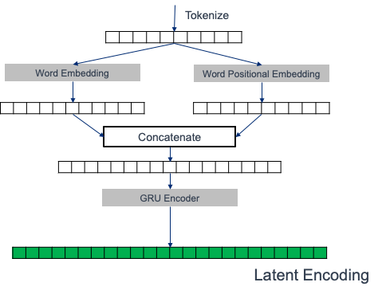
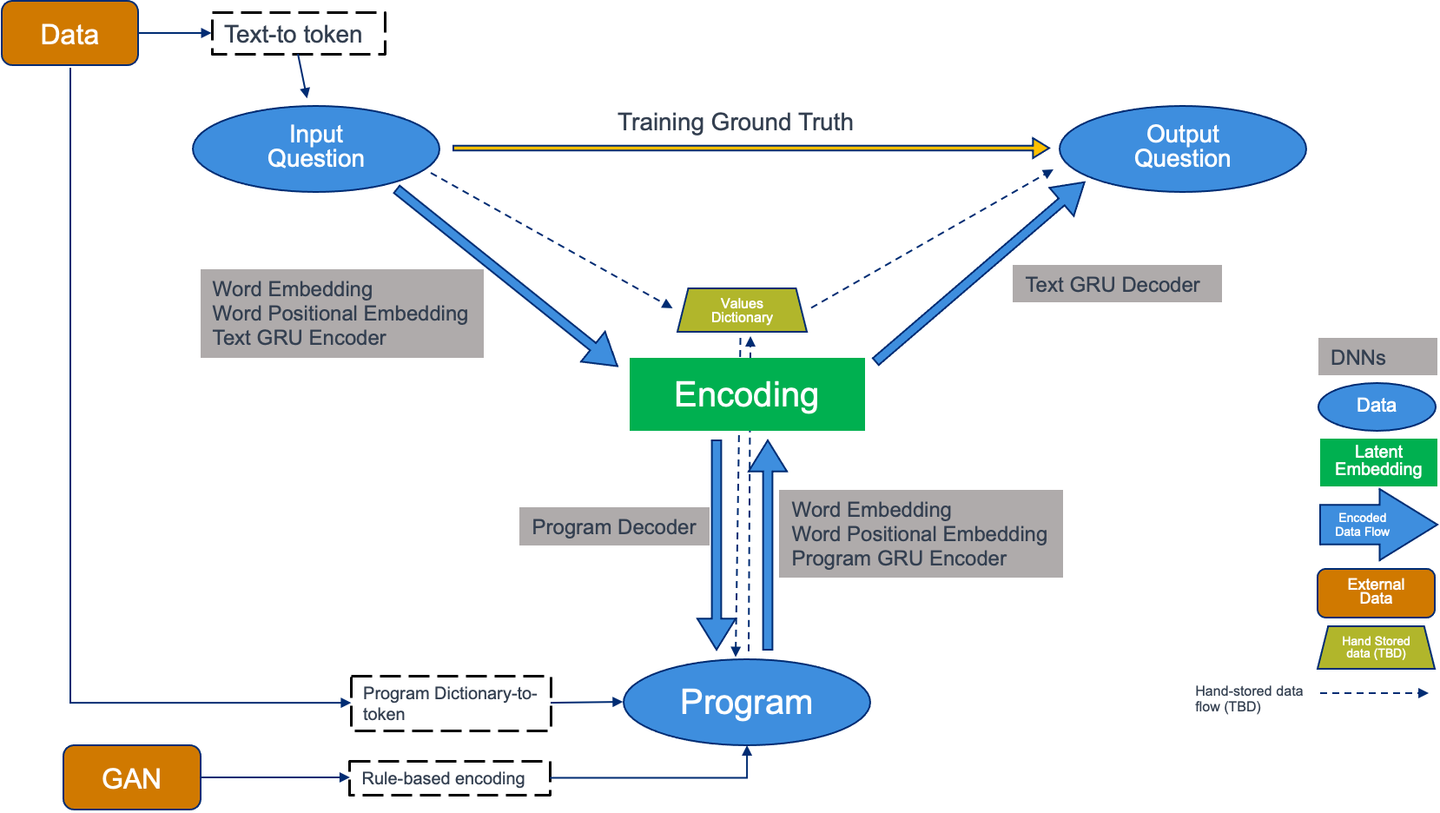
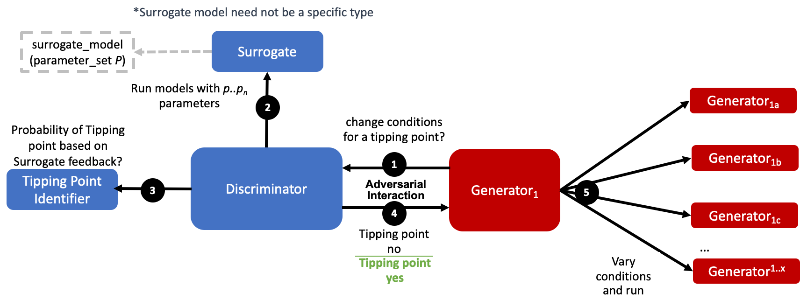
If I increase Ekman flux by some amount, does overturning increase?
What did we do?
TIP-GAN [4,5]
Neuro-symbolic Learner [4,6]
The Physics-informed AI Climate Model Agent Neuro-symbolic Simulator (PACMANS) for Tipping Point Discovery

Slide 6
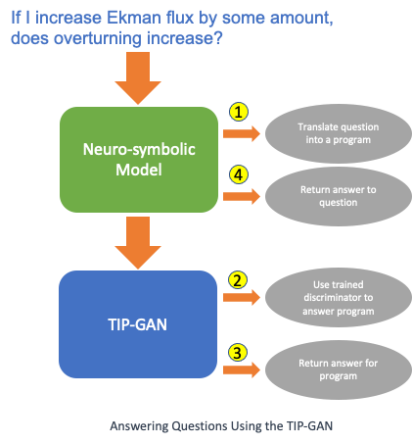
What did we do?
Neuro-symbolic Program Representation
“IncreaseOf(surrogate_model(IncreaseBy(Ekman, 2.7e7)),M_n)”
Program to Vector Representation
Answering Questions Using the Neuro-symbolic Translator and TIP-GAN
The Physics-informed AI Climate Model Agent Neuro-symbolic Simulator (PACMANS) for Tipping Point Discovery

Slide 7
How did we do?
 | Precision | Recall | F-Measure
AMOC Off | 100% | 100% | 100%
AMOC ON | 100% | 100% | 100%
We ran an experiment where we used the neuro-symbolic translator and TIP-GAN together
The neuro-symbolic translation from question to program was evaluated on translating the 2000 questions.
Question Types:
If v1 is value will AMOC collapse?
If v2 is value will AMOC collapse?
If v1 is value and v2 is value will the AMOC collapse?
TIP-GAN was evaluated on how well it did at predicting the outcome of AMOC collapse (without running the surrogate model)
Running the surrogate model took .96 seconds on average for each question compared with 5.4×10⁻⁶ seconds.
Neuro-symbolic performance in translating natural language questions to programs. Evaluated on how accurately it translated the question to the correct program structure - it appears to have performed very well.
 | Precision | Recall | F-Measure
AMOC Off | 99.602% | 100% | 99.8%
AMOC ON | 100% | 99.600% | 99.8%
TIP-GAN Prediction Performance for the 2000 questions translated into programs.
 | Neuro-symbolic Translation | TIP-GAN Prediction | Full AI Simulation
Total Average Time in seconds | 0.04 | 0.0000054 | 0.045
Average time in seconds to perform the translation from question to program and to obtain an answer to the program. The final column is the overall AI Simulation total time.

Slide 8

We can answer questions very quickly!
If Ekman Flux is 28226923.55 and Northern Hemisphere Freshwater Flux is 840575.51, does the AMOC collapse?
What about my harder question?

Slide 9
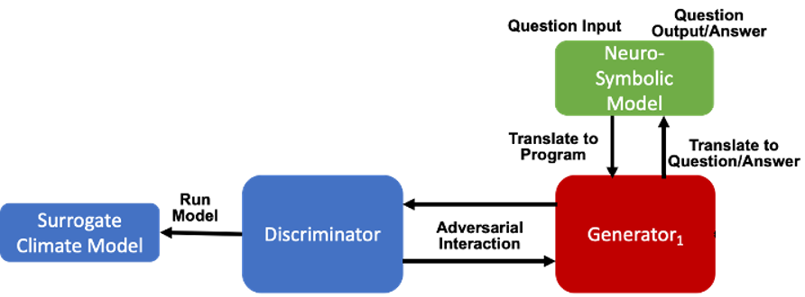
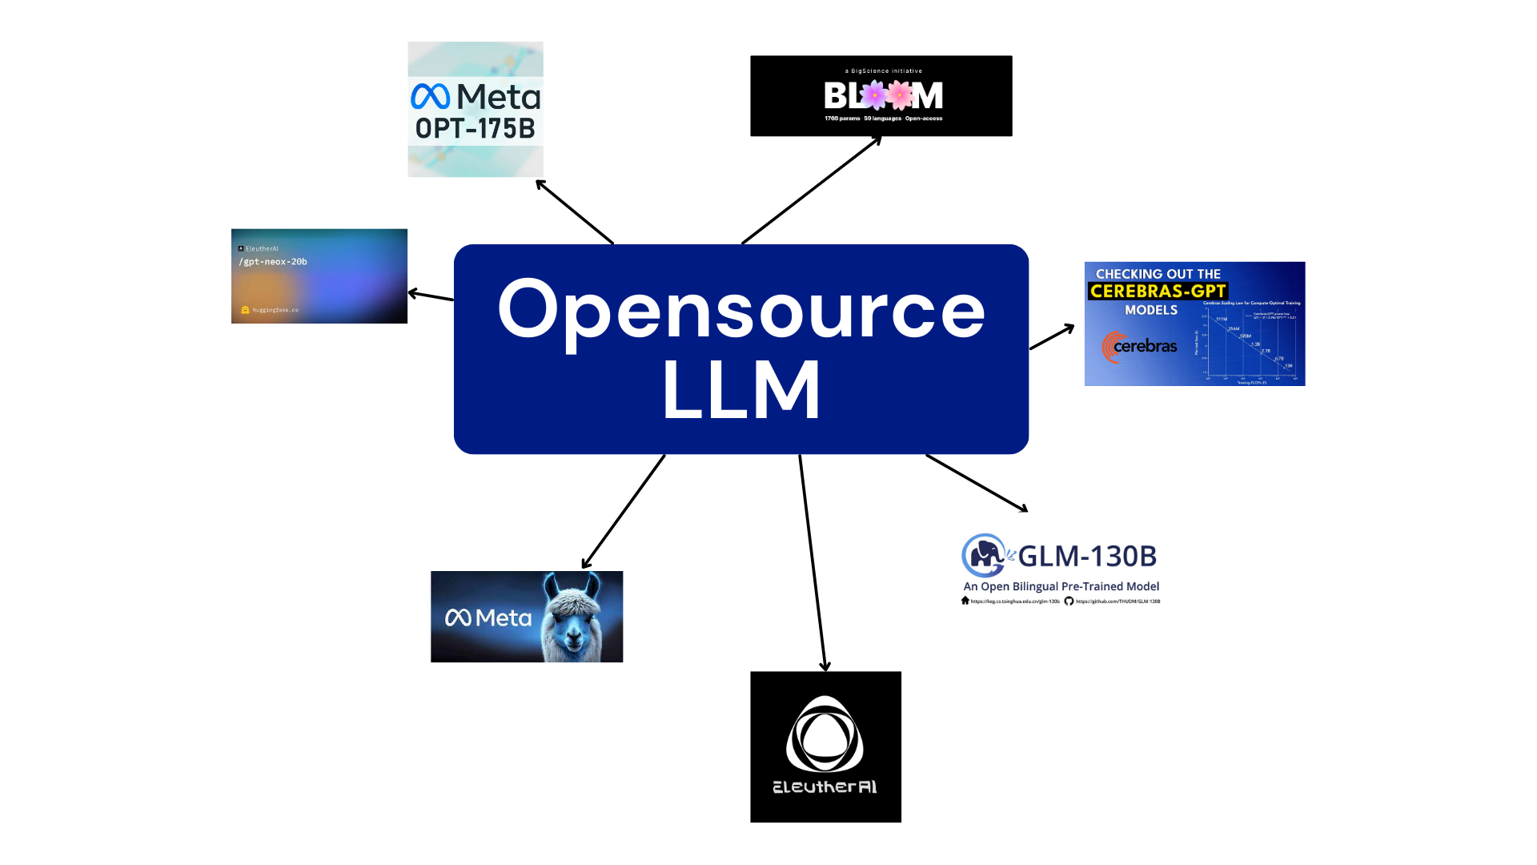

What are we planning?
Simple question that maps to model vector
Complex question that is realistic to an oceanographer
If I increase Ekman flux by some amount, does overturning increase?
Does the stability of the overturning depend on the pathways and sensitivities of water mass transformation in the Southern Ocean?

Slide 10
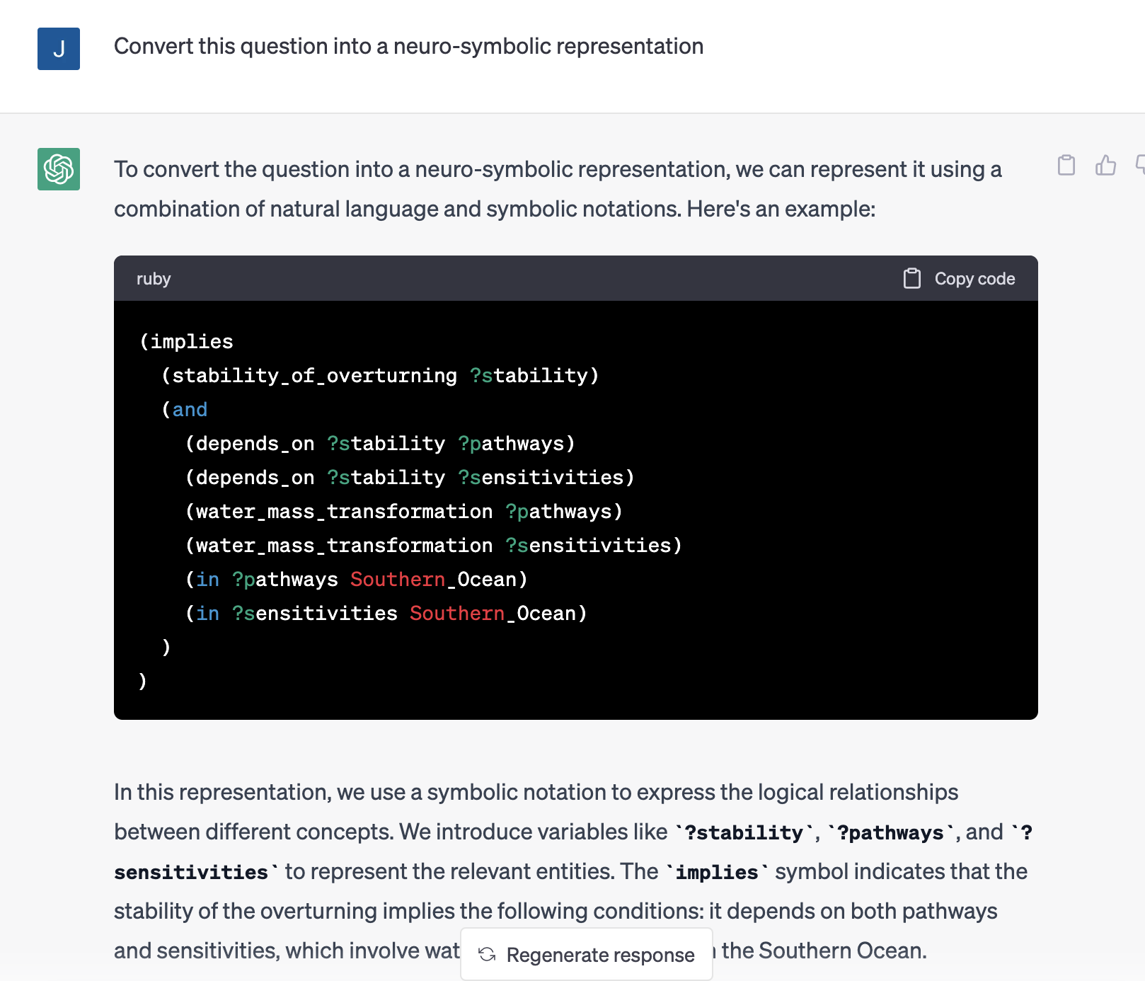
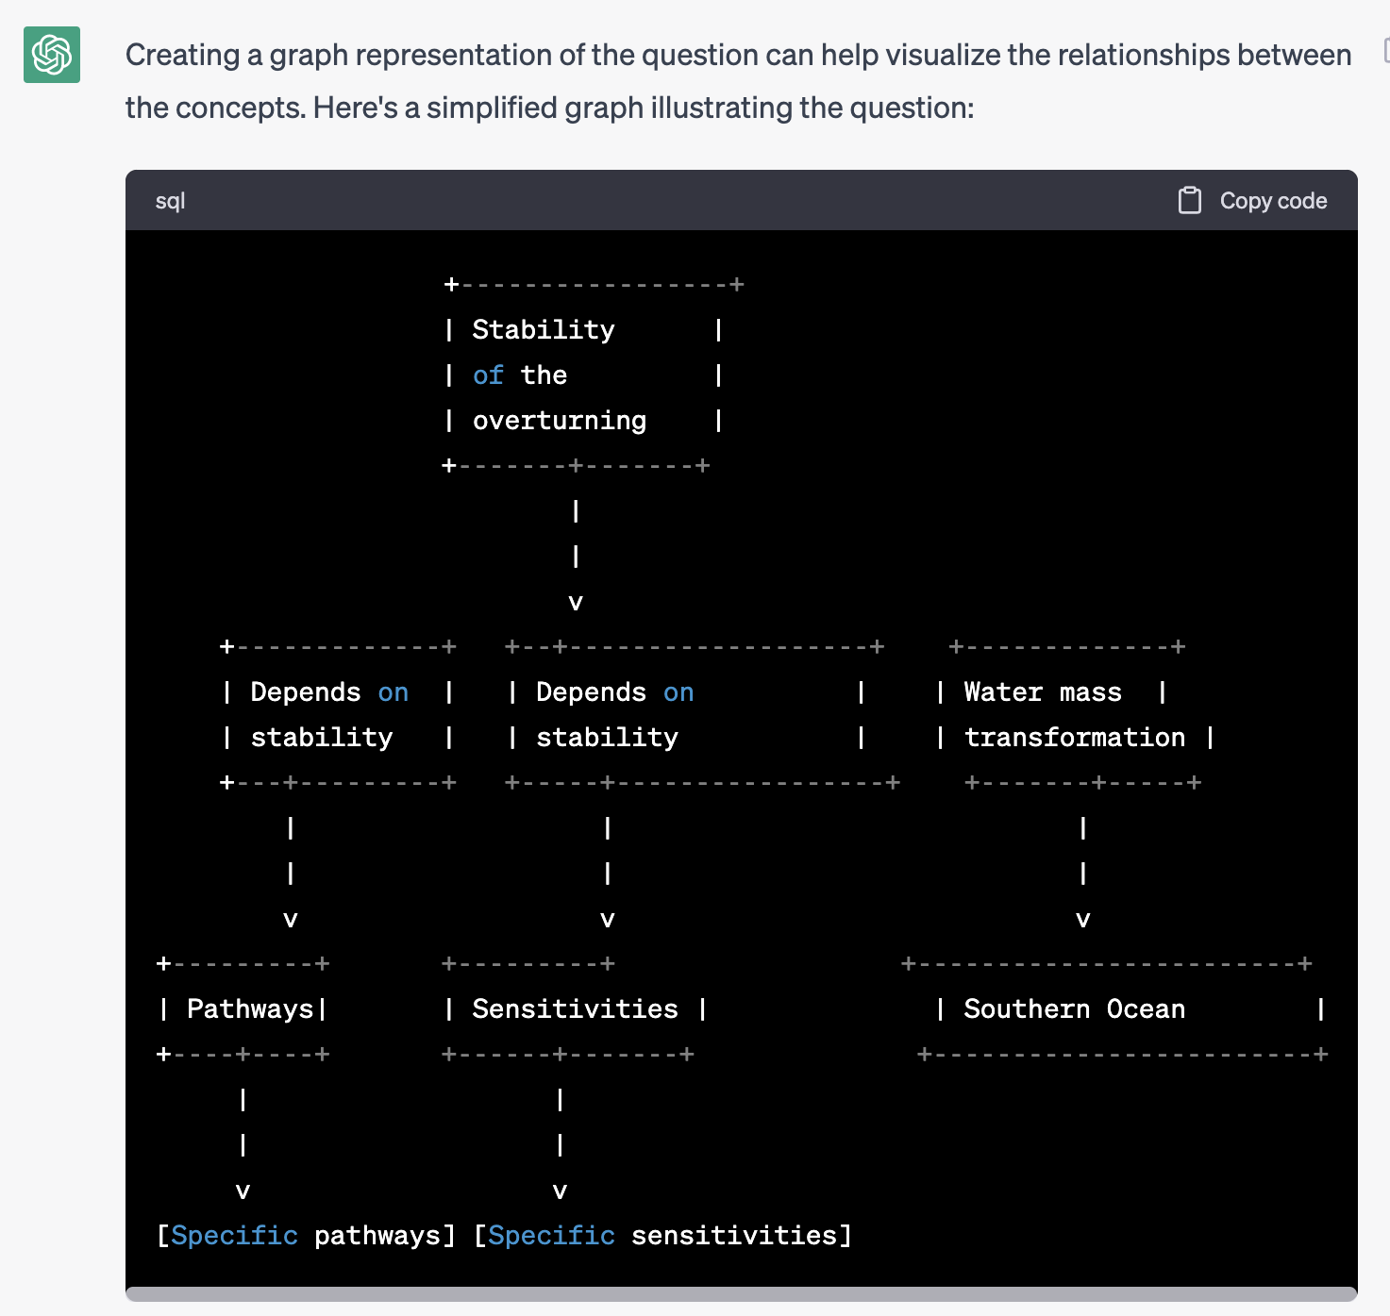
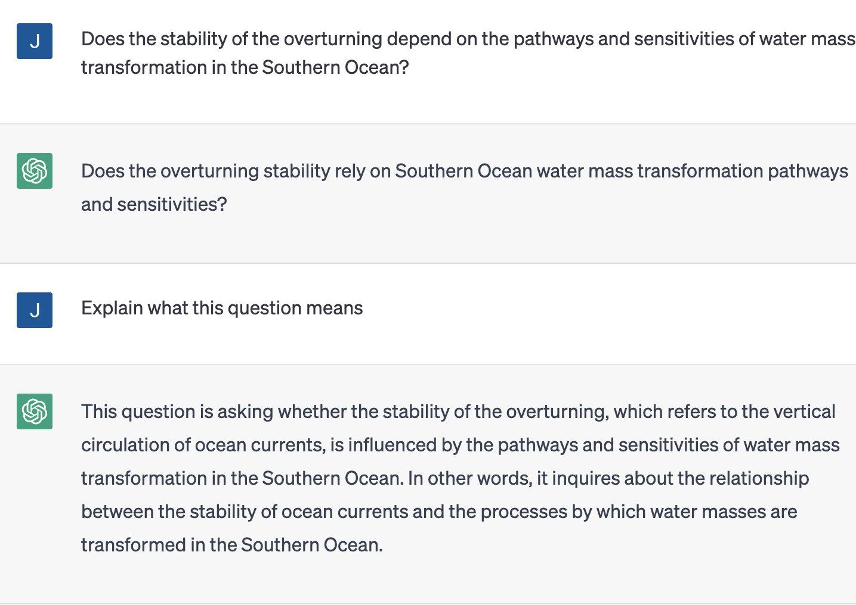
Is it feasible?
With a limited experiment using ChatGPT on a set of “hard” scientific questions we are able to formulate reasonable decompositions of questions.
We expect better results when we train our own LLM using scientific literature
We ask the question, are we able perform automatic symbolic generation?

Slide 11
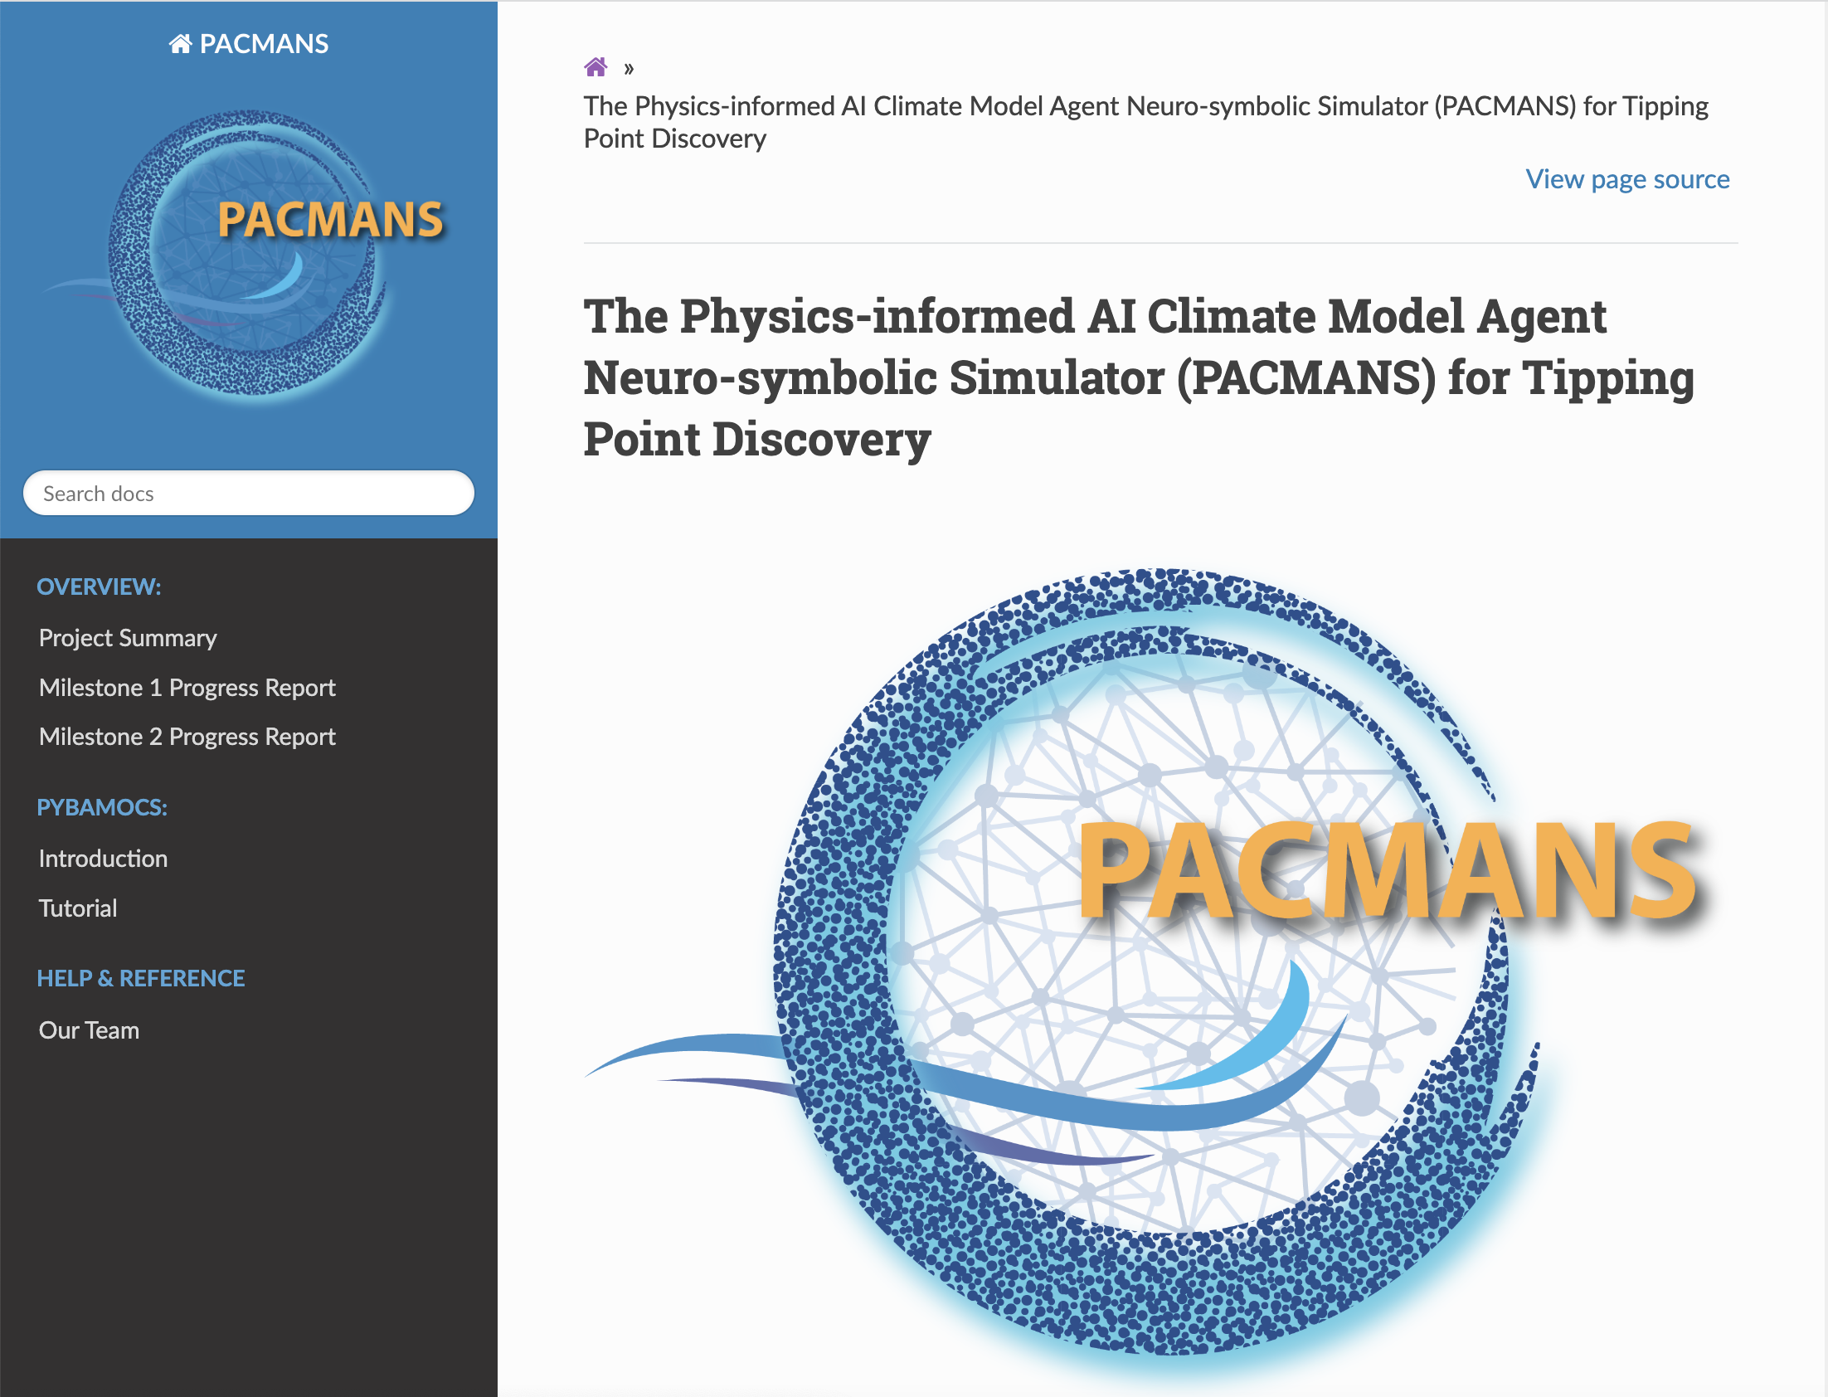
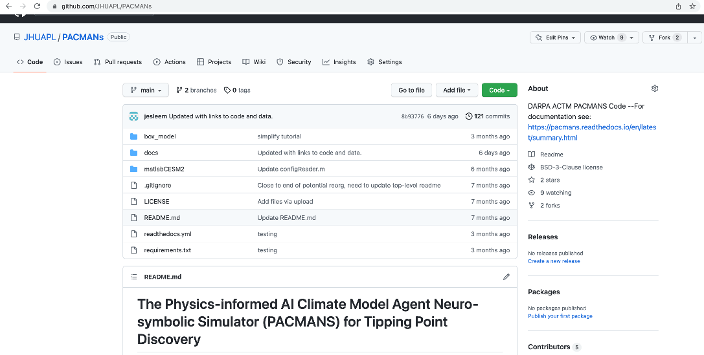
Interested in learning more about AI methods for Climate Tipping Point Discovery?
Gnanadesikan, Anand, Gianluca Fabiani, Jingwen Liu, Renske Gelderloos, G. Jay Brett, Yannis Kevrekidis, Thomas Haine, Marie-Aude Pradal, Constantinos Siettos, and Jennifer Sleeman. "Tipping points in overturning circulation mediated by ocean mixing and the configuration and magnitude of the hydrological cycle: A simple model." arXiv preprint arXiv:2308.03951 (2023).
Gnanadesikan, Anand, Jay Brett, Jennifer Sleeman, and David Chung. "Using AI to Detect Climate Tipping Points-Or Why It’s Hard to Understand Rapid Changes in the Earth System." (2023).
Brett, Jay, David Chung, Jennifer Sleeman, and Anand Gnanadesikan. "Lightning Talk: Atlantic Meridional Overturning Circulation (AMOC) Tipping Point: A GAN Test Case." (2023).
Sleeman, Jennifer, David Chung, Chace Ashcraft, Jay Brett, Anand Gnanadesikan, Yannis Kevrekidis, Marisa Hughes et al. "Using Artificial Intelligence to aid Scientific Discovery of Climate Tipping Points." arXiv preprint arXiv:2302.06852 (2023).
Sleeman, Jennifer, David Chung, Anand Gnanadesikan, Jay Brett, Yannis Kevrekidis, Marisa Hughes, Thomas Haine et al. "A Generative Adversarial Network for Climate Tipping Point Discovery (TIP-GAN)." arXiv preprint arXiv:2302.10274 (2023).
Ashcraft, Chace, Jennifer Sleeman, Caroline Tang, Jay Brett, and Anand Gnanadesikan. "Neuro-Symbolic Bi-Directional Translation--Deep Learning Explainability for Climate Tipping Point Research." arXiv preprint arXiv:2306.11161 (2023).
PACMANS is open source

